Slide 1

Retail Sales Assessment
Understanding our customers and shops for all of
December, January and February.

Slide 2
Introduction
We have been given two datasets, and we have been tasked with translating the data for team leaders and executives.
We have two active subjects with the metrics of whom we are concerned.
Shops
Customers
We have one passive subject
Item
Tableau Link

Slide 3
Clean the Data and build Dashboards
Using a Jupyter notebook, clean the data
Using Tableau, build Dashboards

Slide 4
How to Decide What to do in Tableau
I started with the post-webinar message sent by Anastasia to get ideas. I had some basic ideas in mind, subjects and metrics, but I didn’t know how to translate them to Tableau.
Phase I
Edureka Playlist, Tableau Tips, Context Filters, Tableau Jedi's Tips and Tricks
All Tableau Functions
Then I played around in Tableau until I found my limits.
I made simple charts using my three subjects, Customer, Shop and Item, and I looked for valueable metrics.

Slide 5
Build My Vision of my Dashboard
Phase II
Ask questions about my data and the metrics I’m using to evaluate them.
Who are ouir valuable customers who have yet to join the Loyalty program?
How do our shops comparitively perform
These answers lead me to test out different metrics of comparison.
Build charts that answer my questions.
Build each chart individually to answer a specific question
Add filters
Format the charts in an easily understandable way

Slide 6
Organize Dashboard into a Story
Phase III
Find charts that help each other tell a story and put them on the same dashboard
Create multiple dashboards with in a Story, each focusing on a question I had and the answer I got
Make sure all the filters are working as expected
Making sure we’re not getting any crazy resulty
Polishing the look to make sure everything is clear

Slide 7
Jupyter Charts
Some basic charts from my Jupyter notebook

Slide 8
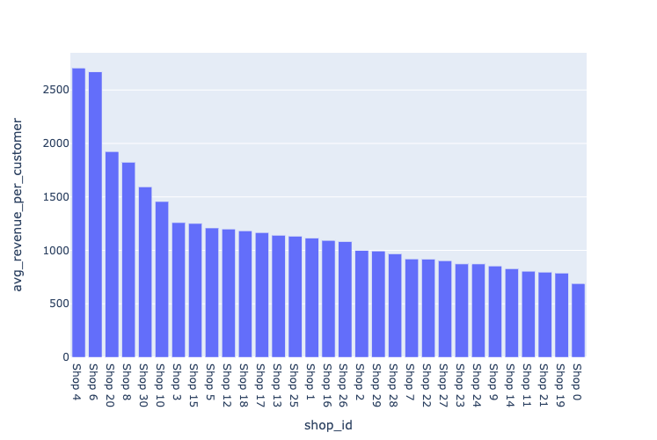
Average Total Revenue per Customer per Shop

Slide 9
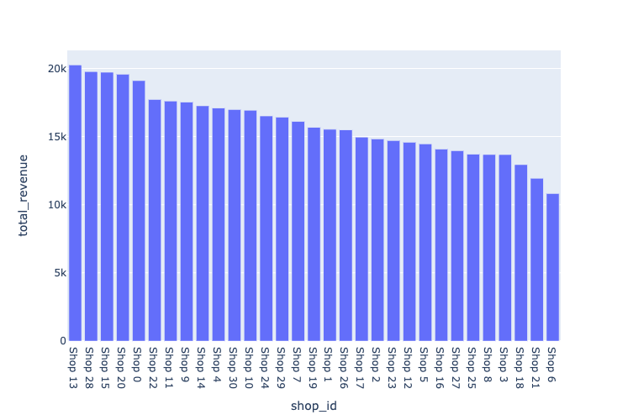
Total Revenue per Shop

Slide 10
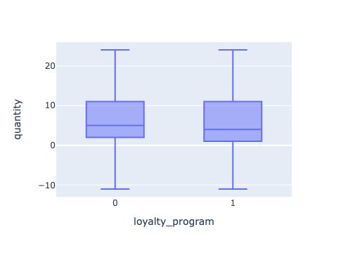
Boxplot and Conclusions
1) t-test results: t-statistic = -35.55, p-value = 0.00
The means of revenue per customer are significantly different
2) ANOVA results: F-statistic = 6.09, p-value = 0.00
There is a significant difference of the means of the purchase price
3) Chi-squared test results: chi-square statistic = 621.98, p-value = 0.00
The chi-square statistic of 621.98 indicates that there is a significant relationship between the Shop and Loyalty
Our p-value is less than 0.05 in all tests, which suggests that the difference between the means is unlikely to be due to chance.

Slide 11
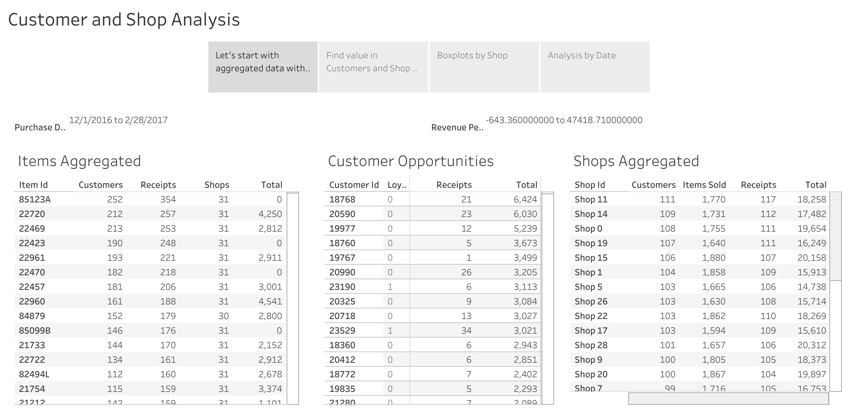
Preview of Tableau. Click here for interactivity.

Slide 12
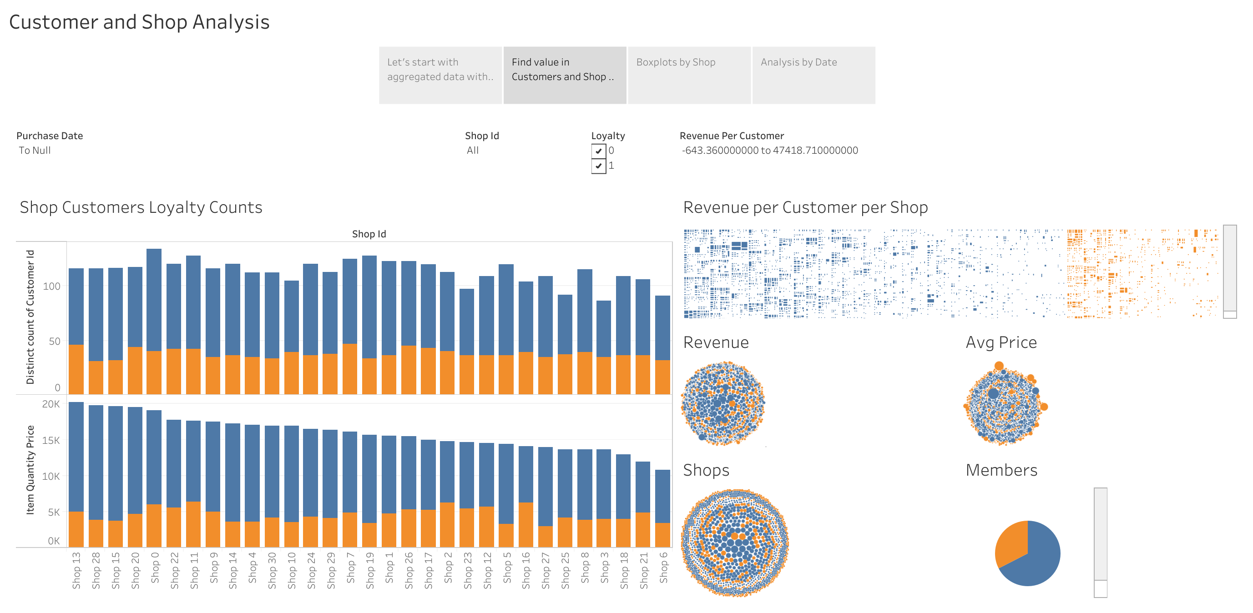
Preview of Tableau. Click here for interactivity.

Slide 13
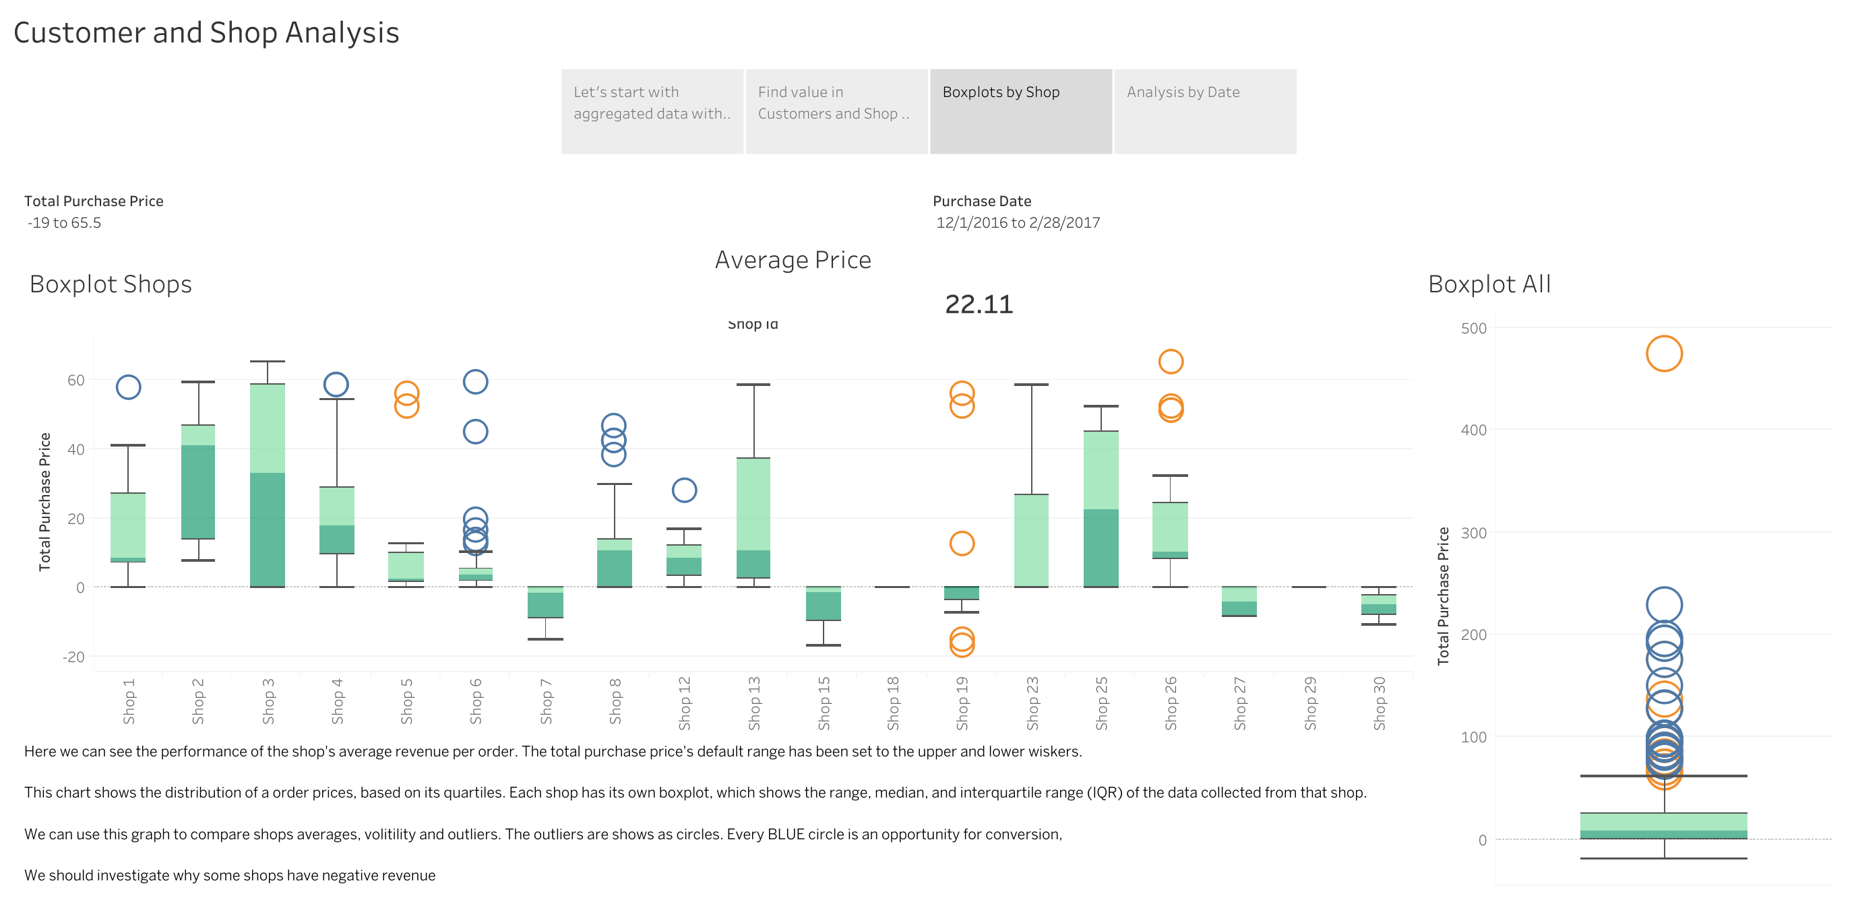
Preview of Tableau. Click here for interactivity.

Slide 14
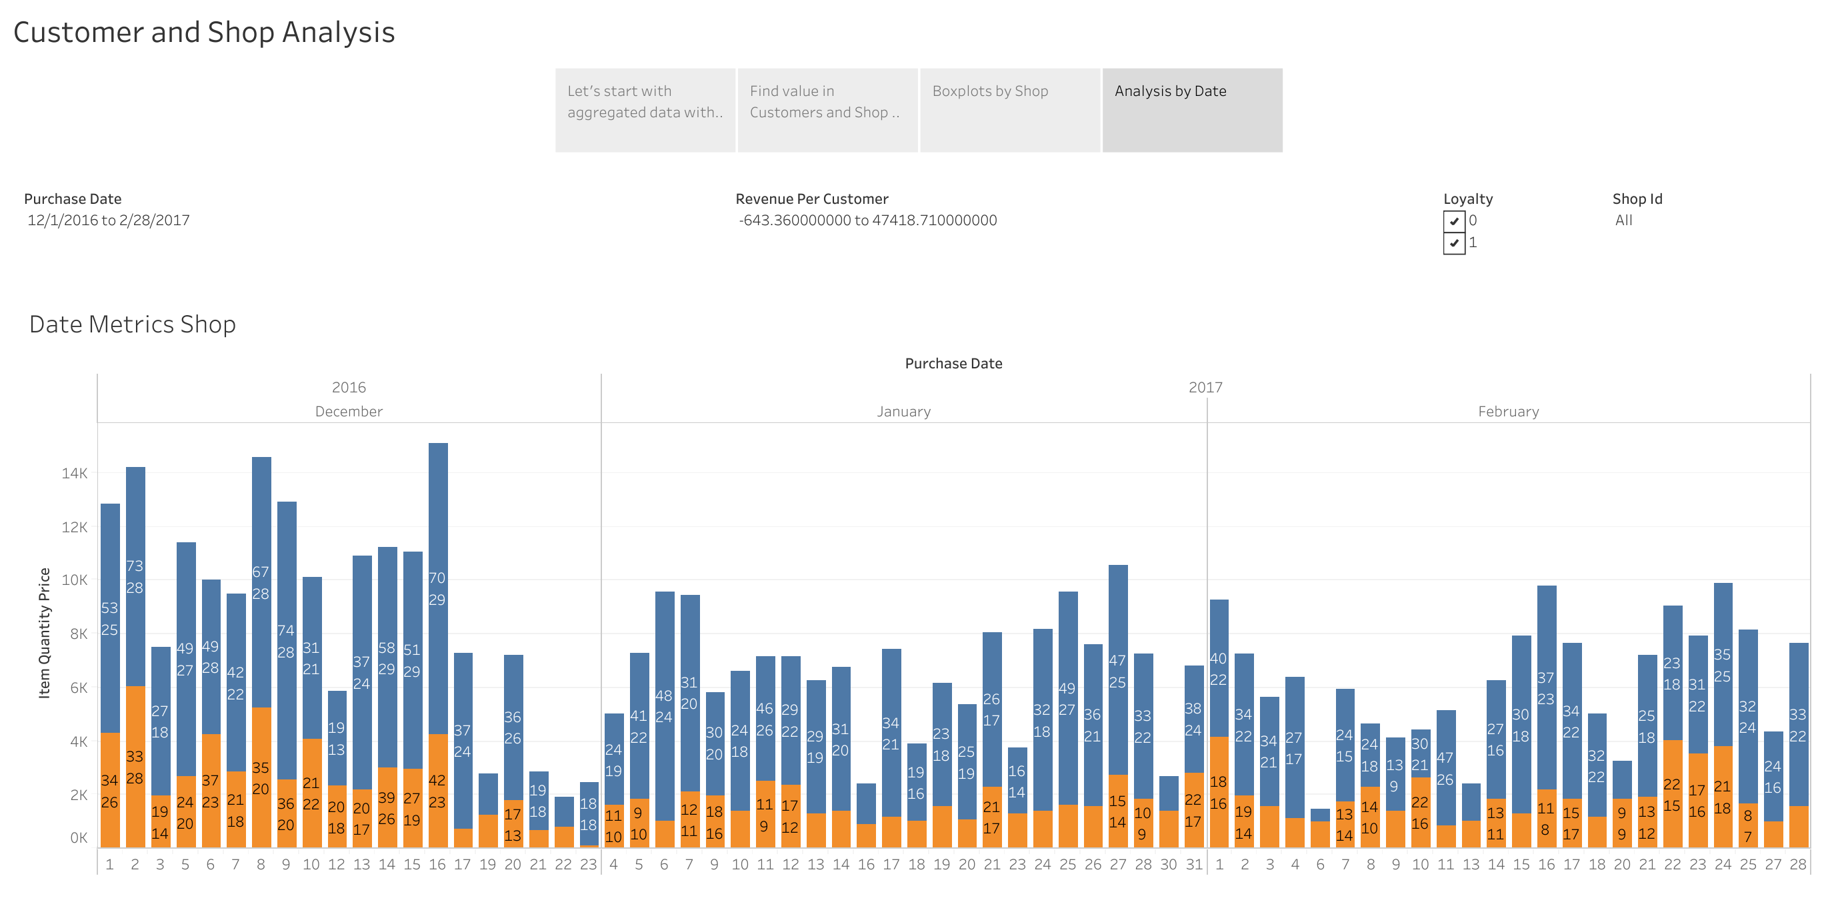
Preview of Tableau. Click here for interactivity.

Slide 15
Summary
Our top spending customer, 18768 spent $6,424 through our testing period, and he is not a member of our Loyalty program. Let’s fix that.
Most of our best customers are not Loyalty members. Let’s fix that too.
Our best performing shop is shop 13 with $20,612
Shop 0 sold the most selling 1,755 and had the most receipts with 24
Shop 11 has the most customers with 111.

